Slide 1
Automated check Processing

Slide 2
Objective
Our understaing of prcess
To create an automated check processing which helps to
1. Verify signature
2. Using optical character recognization, converts amount, receiver and automates
data entry in journal
3. Using Machine learning and artifical intelligence

Slide 3
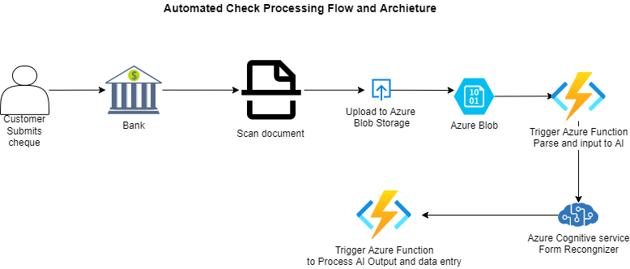
Objective
Process Flow

